Slide 1
Welcome to the Lt. Governor’s Computing Challenge
What is the purpose of the Coding for Good challenge?
What does it look like?
How can I get my students/members involved?
What is the best way to support them?
Who will support me???

Slide 2
Who is eligible?
Youth in Grades 3-12 living in Connecticut
Individuals or teams
Teams may have up to 5 members
Members must be in the same grade band
Grade Bands
3-5, 6-8, 9-12

Slide 3
Coding for Good
Spread positive messages.
Tackle important issues.
Promote healthy habits.

Slide 4
https://www.ltgovcc.org/
Where is the information?

Slide 5
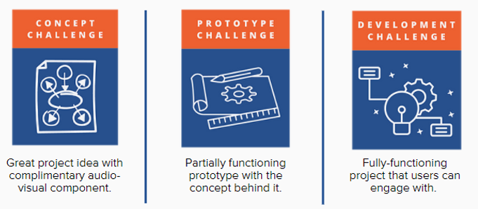
Which will your students choose?
Three levels of challenges

Slide 6
Students submit to one level only.
Concept Challenge
Expectation:
Identify a societal problem/issue
Propose a viable coding solution
Ideation only, no coding/development
Submissions via Google Form:
Written responses to prompts
Audio-Visual

Slide 7
Prototype Challenge
Expectation
Identify a societal problem/issue
Propose a viable coding solution
Develop a prototype/proof of concept
Submissions via Launchpad
Development Plan
flowchart, storyboard, wireframe
Prototype
user interface with a minimum of one programmed, working feature
Video
Written Responses

Slide 8
Submissions due by April 30, 2021
Development Challenge
Expectation
Identify a societal problem/issue
Design a viable coding solution
Develop a working coding solution
Fully Functioning Application
Work with a mentor [optional]
Submissions via Launchpad
Written Responses
Video
Program Code
Working Application [optional]

Slide 9
https://www.skills21.org/ltgovcovid-19challenge
Can I see some examples?

Slide 10
Submission portals open now!
Challenge Timeline
Submissions deadline: April 30, 2021
Review and judging of submissions: May 2021
Recognition event will take place in June of 2021

Slide 11
How can YOU help?
Get thinking:
Encourage your students to explore the website
Brainstorm issues that need to be solved – what is personal to them?
Who will use their app?
Discuss their solutions – are they viable?
Get started:
Decide on a challenge level
Have students sketch their app screens
Choose a coding platform

Slide 12
Coding platforms

Slide 13
How can WE help?
Webinars: https://www.ltgovcc.org/resources
Connect with a mentor: https://forms.gle/mXsEGfngVtYp3oay8
Email info@ltgovcc.org

Slide 14
and sponsors.
Thank you to our funders

Slide 15
Q & A

